Slide 1



Atliq Hotels Dashboard
View in Power BI
Last data refresh:
6/26/2024 5:15:10 PM UTC
Downloaded at:
6/26/2024 5:21:13 PM UTC

Slide 2
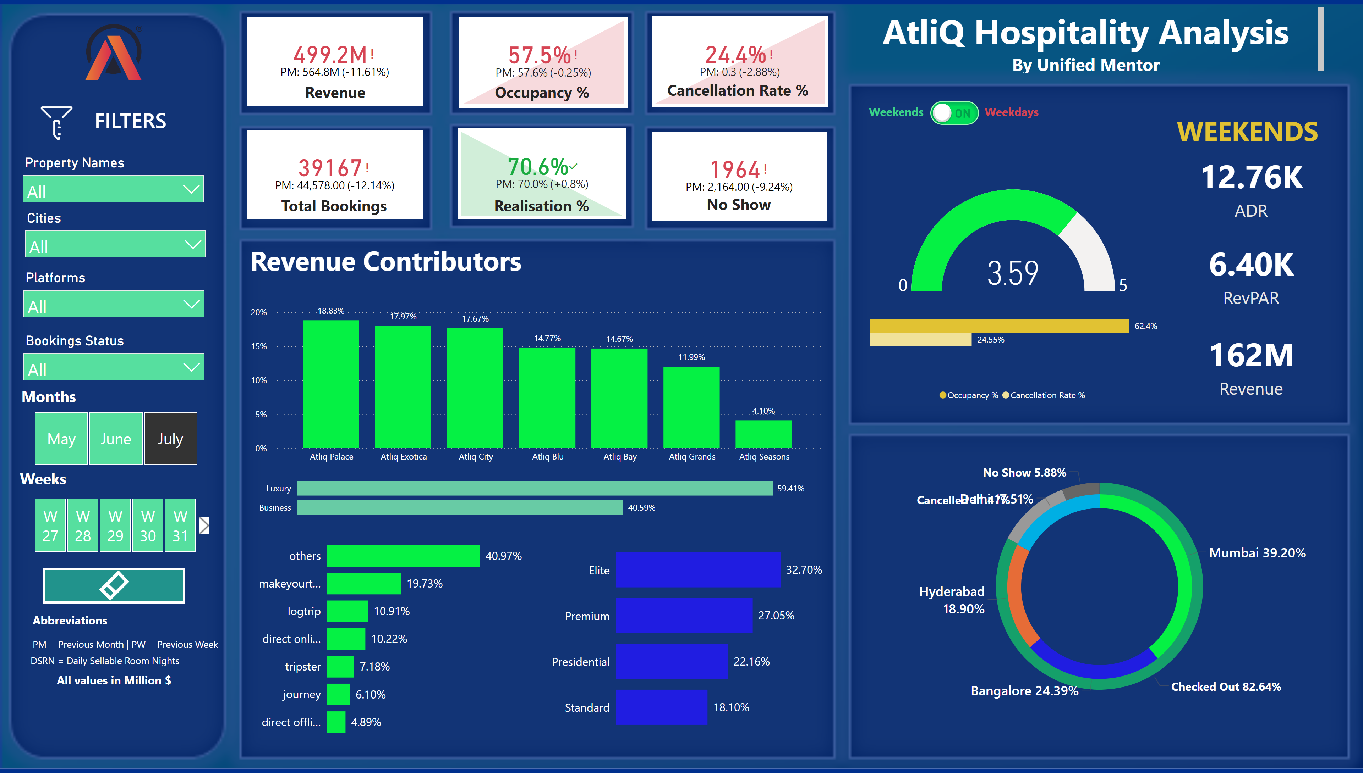
Revenue Key Distributions
Notes:
image
No alt text provided
slicer
No alt text provided
image
No alt text provided
shape
No alt text provided
slicer
No alt text provided
slicer
No alt text provided
slicer
No alt text provided
slicer
No alt text provided
slicer
No alt text provided
kpi
No alt text provided
donutChart
No alt text provided
donutChart
No alt text provided
clusteredBarChart
No alt text provided
clusteredBarChart
No alt text provided
clusteredBarChart
No alt text provided
columnChart
No alt text provided
gauge
No alt text provided
card
No alt text provided
textbox
No alt text provided
card
No alt text provided
clusteredBarChart
No alt text provided
card
No alt text provided
kpi
No alt text provided
kpi
No alt text provided
kpi
No alt text provided
kpi
No alt text provided
kpi
No alt text provided
textbox
No alt text provided
textbox
No alt text provided
textbox
No alt text provided
textbox
No alt text provided
textbox
No alt text provided
textbox
No alt text provided
textbox
No alt text provided
textbox
No alt text provided
textbox
No alt text provided
textbox
No alt text provided
textbox
No alt text provided
card
No alt text provided
card
No alt text provided
card
No alt text provided
clusteredBarChart
No alt text provided
gauge
No alt text provided
image
No alt text provided
textbox
No alt text provided
textbox
No alt text provided
textbox
No alt text provided
image
No alt text provided
textbox
No alt text provided
actionButton
No alt text provided
image
No alt text provided
actionButton
No alt text provided
actionButton
No alt text provided
actionButton
No alt text provided
actionButton
No alt text provided
shape
No alt text provided
shape
No alt text provided
actionButton
No alt text provided
actionButton
No alt text provided
shape
No alt text provided
shape
No alt text provided
shape
No alt text provided
shape
No alt text provided
shape
No alt text provided

Slide 3
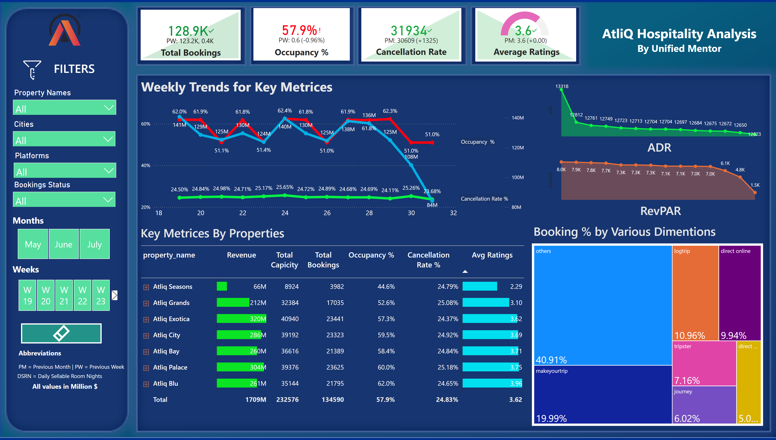
Weekly Key Distributions
Notes:
image
No alt text provided
slicer
No alt text provided
image
No alt text provided
shape
No alt text provided
slicer
No alt text provided
slicer
No alt text provided
slicer
No alt text provided
slicer
No alt text provided
slicer
No alt text provided
kpi
No alt text provided
kpi
No alt text provided
kpi
No alt text provided
kpi
No alt text provided
textbox
No alt text provided
textbox
No alt text provided
textbox
No alt text provided
textbox
No alt text provided
textbox
No alt text provided
textbox
No alt text provided
textbox
No alt text provided
textbox
No alt text provided
lineChart
No alt text provided
pivotTable
No alt text provided
treemap
No alt text provided
shape
No alt text provided
shape
No alt text provided
areaChart
No alt text provided
areaChart
No alt text provided
shape
No alt text provided
shape
No alt text provided
gauge
No alt text provided
actionButton
No alt text provided
shape
No alt text provided
shape
No alt text provided
shape
No alt text provided
shape
No alt text provided
image
No alt text provided
actionButton
No alt text provided
actionButton
No alt text provided
actionButton
No alt text provided
actionButton
No alt text provided
shape
No alt text provided
shape
No alt text provided
actionButton
No alt text provided
actionButton
No alt text provided
shape
No alt text provided

Slide 4
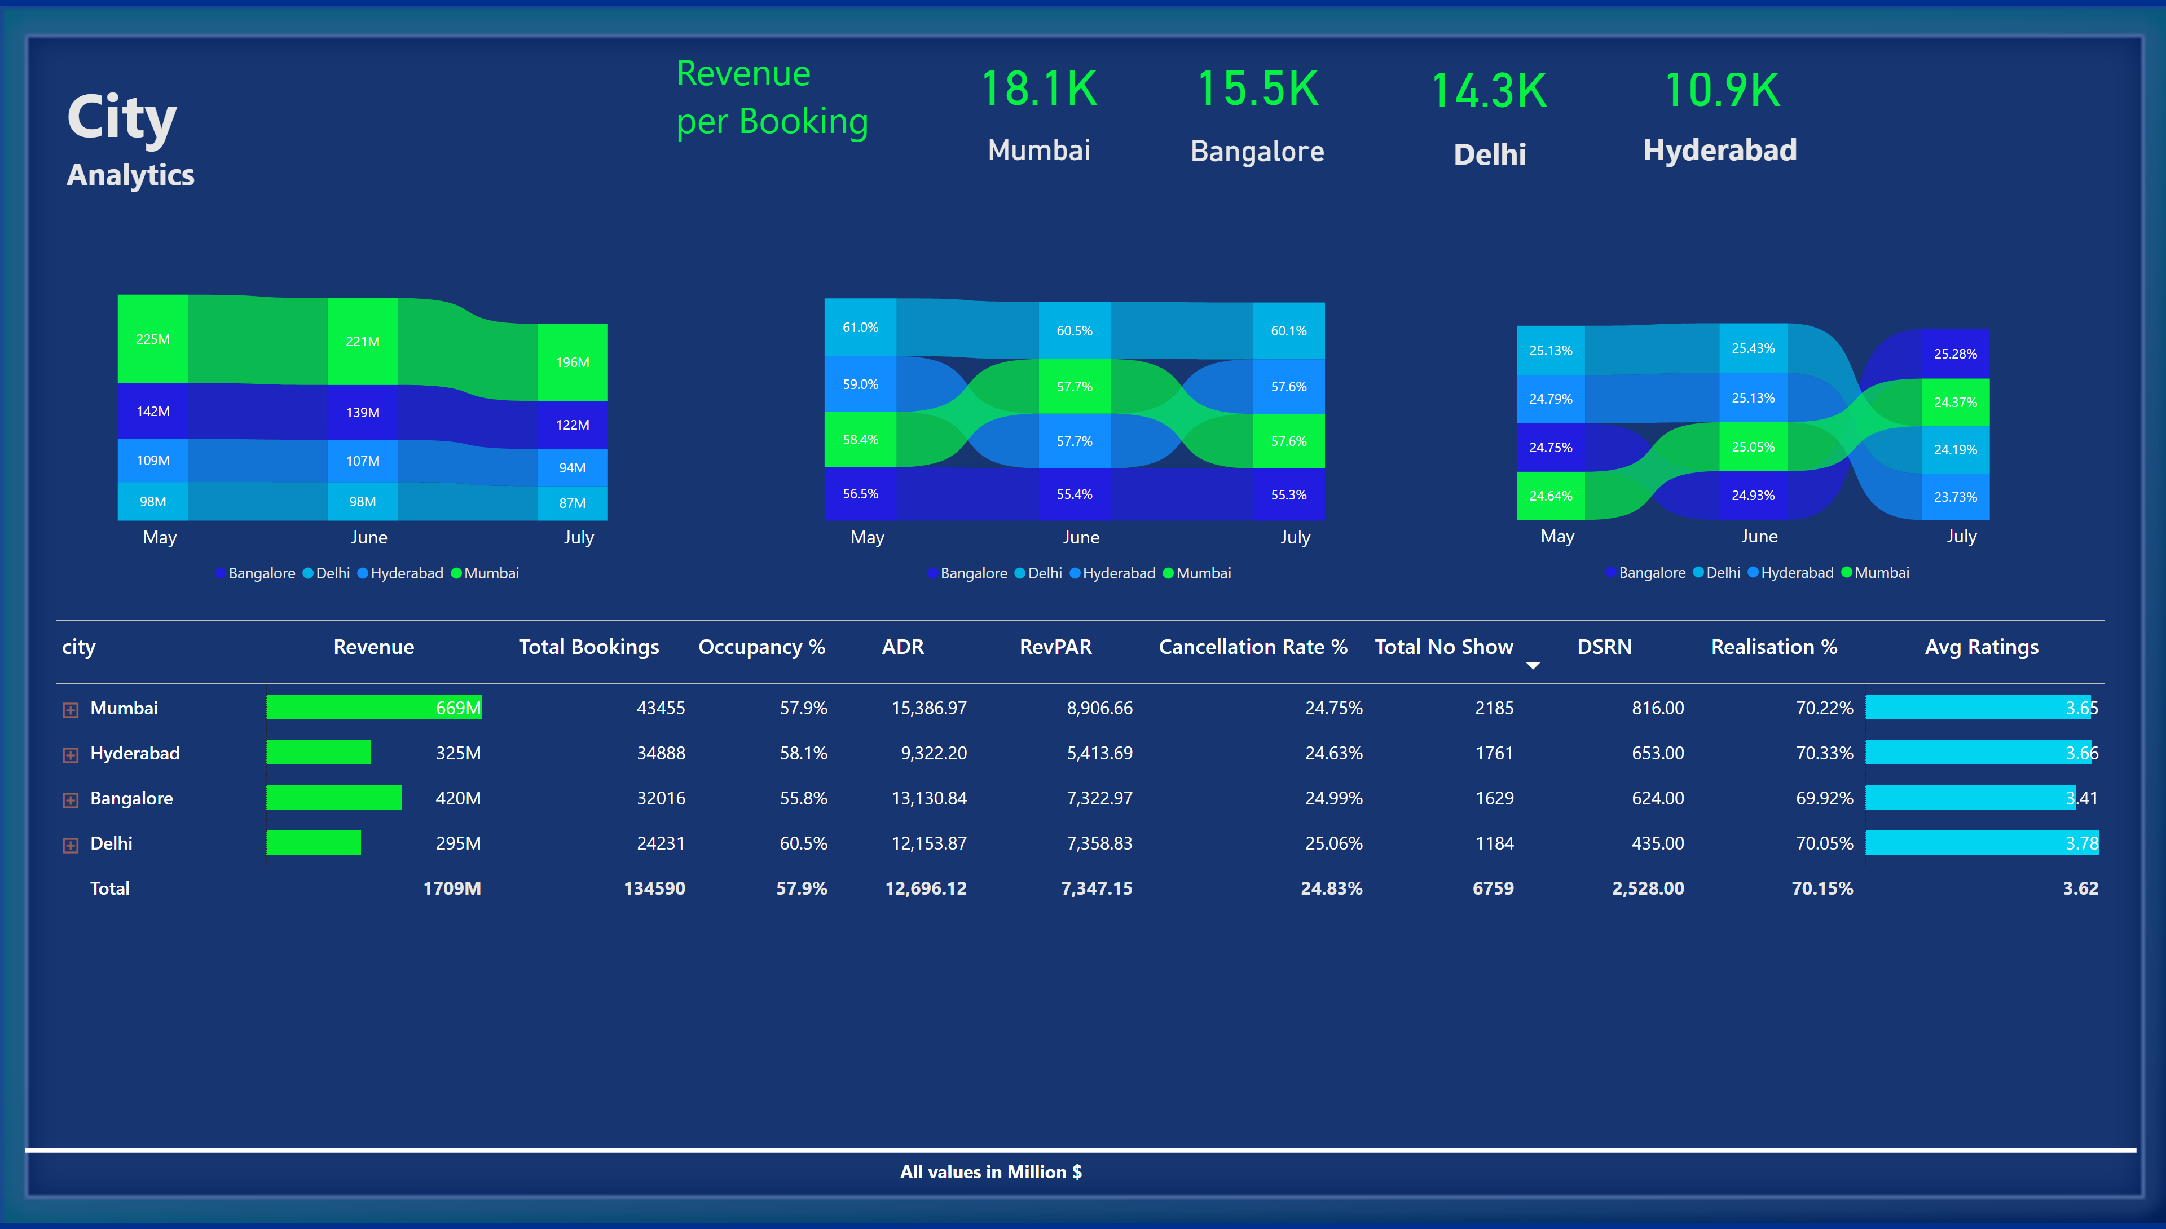
City Key Distributions
Notes:
shape
No alt text provided
textbox
No alt text provided
textbox
No alt text provided
card
No alt text provided
card
No alt text provided
card
No alt text provided
card
No alt text provided
card
No alt text provided
card
No alt text provided
textbox
No alt text provided
textbox
No alt text provided
ribbonChart
No alt text provided
ribbonChart
No alt text provided
ribbonChart
No alt text provided
pivotTable
No alt text provided
shape
No alt text provided
image
No alt text provided
actionButton
No alt text provided
actionButton
No alt text provided
actionButton
No alt text provided
actionButton
No alt text provided
shape
No alt text provided
shape
No alt text provided
actionButton
No alt text provided
actionButton
No alt text provided
shape
No alt text provided

Slide 5
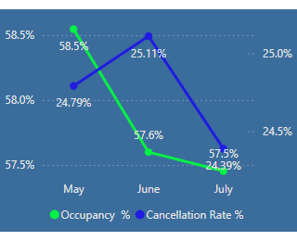
Tooltips
Notes:
lineChart
No alt text provided
lineChart
No alt text provided

